Slide 1
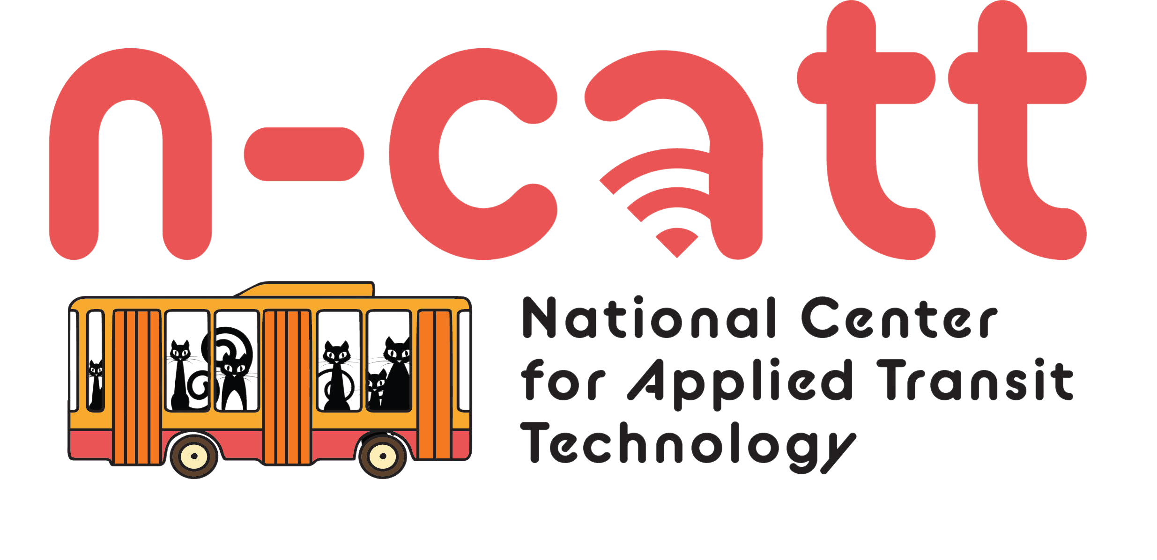
Smart Rural Seminar Grand Rapids, Minnesota
Catalyzing Development through Transportation:
Resources for Your Local Transit Agency Partners
September 21st, 2023

Slide 2
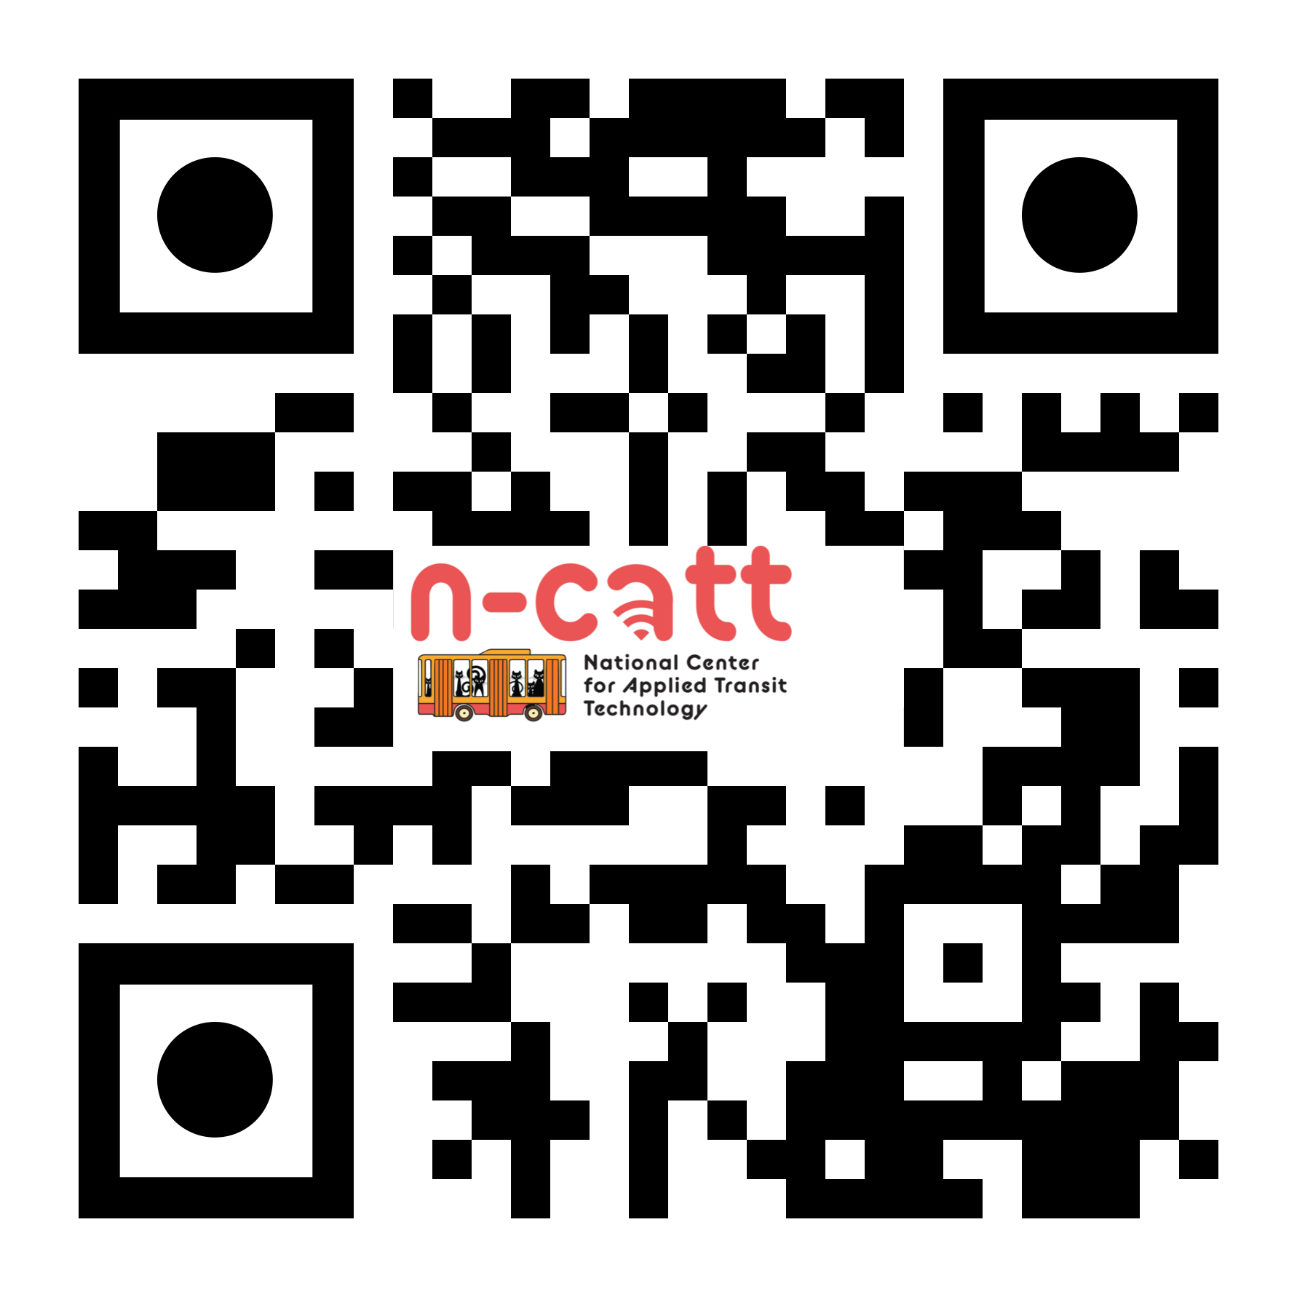
National Center for Applied Transit Technology
Walking small agencies through the technology landscape
Lessons learned, trends, strategies
Enabling Technology Transfer
Tech University
Guidebooks: Practical, actionable information on addressing tech topics
Video profiles: Highlights of innovations in the industry
Podcasts: In-depth discussions of advances in the industry
Webinars: Introductions and Q&As on important tech topics
In the Works
Technology Decision Tools
Cybersecurity Symposium
Data Skills Resources

Slide 3
Technical Assistance
Strategic Technology Technical Assistance Teams (STTATs)
Multiple meetings to identify challenges and goals to identify a road map
Will result in general tech implementation plans, RFPs for technology implementations
Technology Summits
Co-hosted with State DOTs, MPOs, Tribal Consortiums
Identify priorities and road maps for statewide/regional technology investments
Have led to RFPs, working groups, and implementation plans
Workshops
Skill-building events to help managers better make decisions
Open-Source GIS Skills; Service Design Analysis; Data Dashboards

Slide 4
Future N-CATT Content
Cybersecurity Symposium – half-day event to help transit agencies understand their risks and begin developing plans to address risks.
Entry-Level Tech Tools – build simple tools that transit agencies who don’t need sophisticated software can adopt into their systems.
E.g. Google Form complaint tracker
Technology Resilience Resource – an online resource to guide transit agencies through resilience planning for their technology systems.
Implementation Worksheets – a series of worksheets on implementing new technologies that agency staff can use to visualize how they might address the various components of implementing new technologies. Intended to build on the content from guidebooks and other activities.

Slide 5
FTA Sponsored Technical Assistance Programs
National Center for Mobility Management (NCMM): Connects people to transportation options, working across sectors.
National Aging and Disability Transportation Center (NADTC): transportation options that serve the needs of people with disabilities, seniors and caregivers.
National Rural Transit Assistance Program (RTAP): Free training, workshops, resources for rural & tribal agencies.
Transit Planning 4 All (TP4A): Inclusive and coordinated transportation planning, evolving into Accessible Transportation Resource Center (ATRC).
Shared Use Mobility Center (SUMC): Pilot programs, conducts new research, and provides policy and technical expertise to cities and regions.

Slide 6
U.S. Department of Transportation (USDOT) Programs
Thriving Communities FY 23 Program:
Capacity Builders provide technical assistance for transformative projects in disadvantaged communities.
Railroad Crossing Elimination Grant Program:
Improve highway-rail grade crossings and improve mobility.
Rebuilding American Infrastructure with Sustainability and Equity (RAISE) Grant:
Examples: Rebuilding bridges, street grade separation, utility relocation, community connectivity & multimodal enhancements.
Areas of Persistent Poverty Program & Historically Disadvantaged Communities:
Pilot Program for Transit-Oriented Development (TOD) Planning:
Land use reform, transportation, housing, mixed use development.
Enhanced Mobility of Seniors & Individuals with Disabilities - Section 5310
Grants for Buses and Bus Facilities Program- For capital projects, buses, vans, facilities of fixed route operators.

Slide 7
USDOT Programs
Rural Opportunities to Use Transportation for Economic Success (ROUTES): Supports rural transportation policy and equitable access for rural and Tribal communities challenged by transportation safety, mobility, and economic development.
Reconnecting Communities and Neighborhoods Grant Program: Planning & Technical Assistance, Capital Construction funding for communities burdened by past transportation infrastructure decisions.
Strengthening Mobility and Revolutionizing Transportation (SMART) Grants Program: Purpose-driven innovation to build data and technology capacity. Two stages, Planning & Prototyping, Implementation.
Route Planning Restoration Program: Planning to restore routes impacted by COVID-19.
Capital Investment Grants (5309):
Formula Grants for Rural Areas (5311):

Slide 8
Federal Financing Programs
Financing Infrastructure to Move America Forward:
Roads, Airports, Rail, Transit, & Ports.
Rural project initiatives
Transportation Infrastructure Finance and Innovation Act (TIFIA) - Provides credit assistance for qualified projects of regional and national significance. Large-scale, surface transportation projects - highway, transit, railroad, intermodal freight, and port access.
Railroad Rehabilitation and Improvement Financing (RRIF) – Provides loans and direct guarantees to finance development of railroad infrastructure. This includes intermodal facilities and transit-oriented development.
Notes:
Beneficial terms, loan interest rate, flexible amortization, up to 35 years, interest not accrued until proceeds are drawn

Slide 9
Other Avenues
U.S. Economic Development Administration:
Department of Energy:
Housing & Urban Development:
Rural Health Information Hub:
Rural Economic Development Loan & Grant Program:
Department of Health & Human Services:
Important Bookmarks!
Federal Register- all things federal, proposed legislative changes, funding updates & more
Grants.Gov- federal grants repository.
Do you know of any?!

Slide 10
Eligible Entities
Check, double, and triple check the NOFO!
Exceptions apply, but generally…
States
Political subdivision of a State i.e. counties, municipalities, transit agency/authority, etc.
Federally recognized Indian Tribes
Unit of local government or group of local governments
Public authorities (port, economic development, transportation, etc.)
Planning Organizations (MPOs, RPOs)
A group of entities described above

Slide 11
May require…
Project narrative, initial planning study, environmental review, review alternatives, select locally preferred alternative (LPA), and more!
Complete engineering & design
FTA project evaluation, rating & approval
Local financial commitment- 20% local match or more?
Value for Money (VfM) analysis for TIFIA loan security
Benefits-Cost Analysis: Required for discretionary grants. Compares benefits of project, NPV, Build/No-Build scenarios, etc.
Remember to
Review the NOFO!
Attend the grant webinar(s)
Meet with the Project Officer

Slide 12
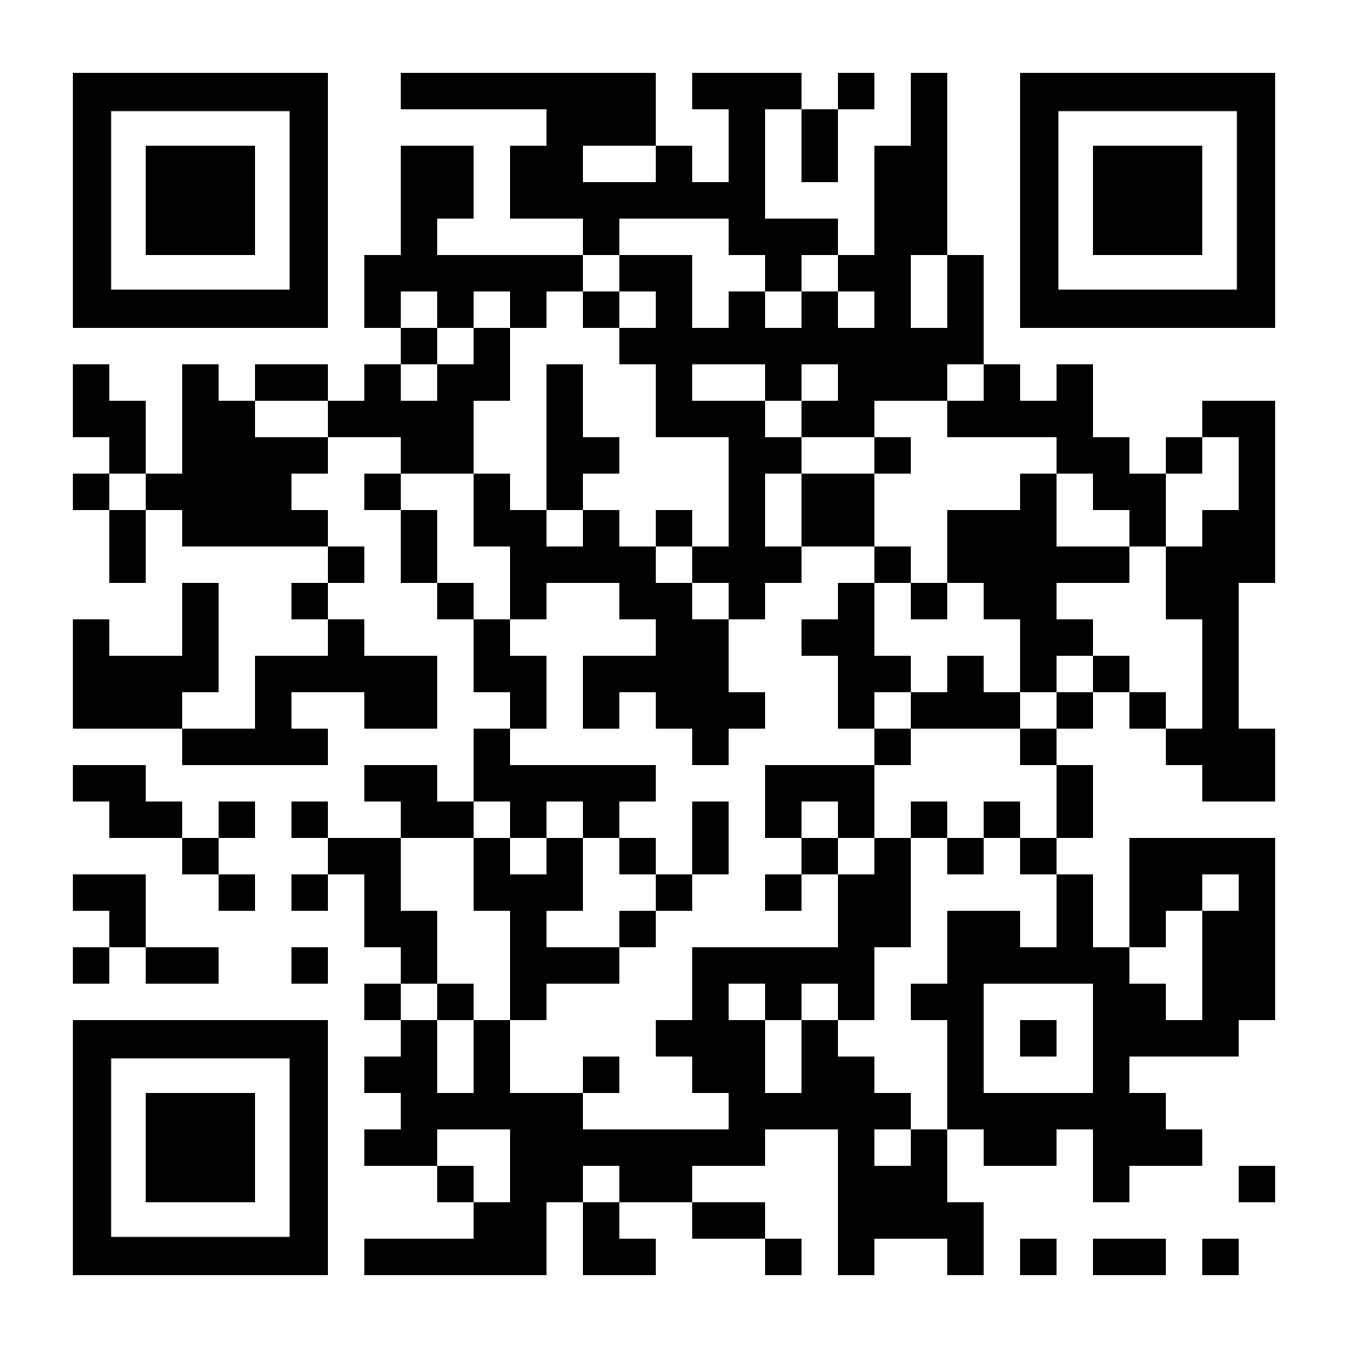
Download this PowerPoint!
https://n-catt.org/smart-rural-seminar-presentation/

Slide 13
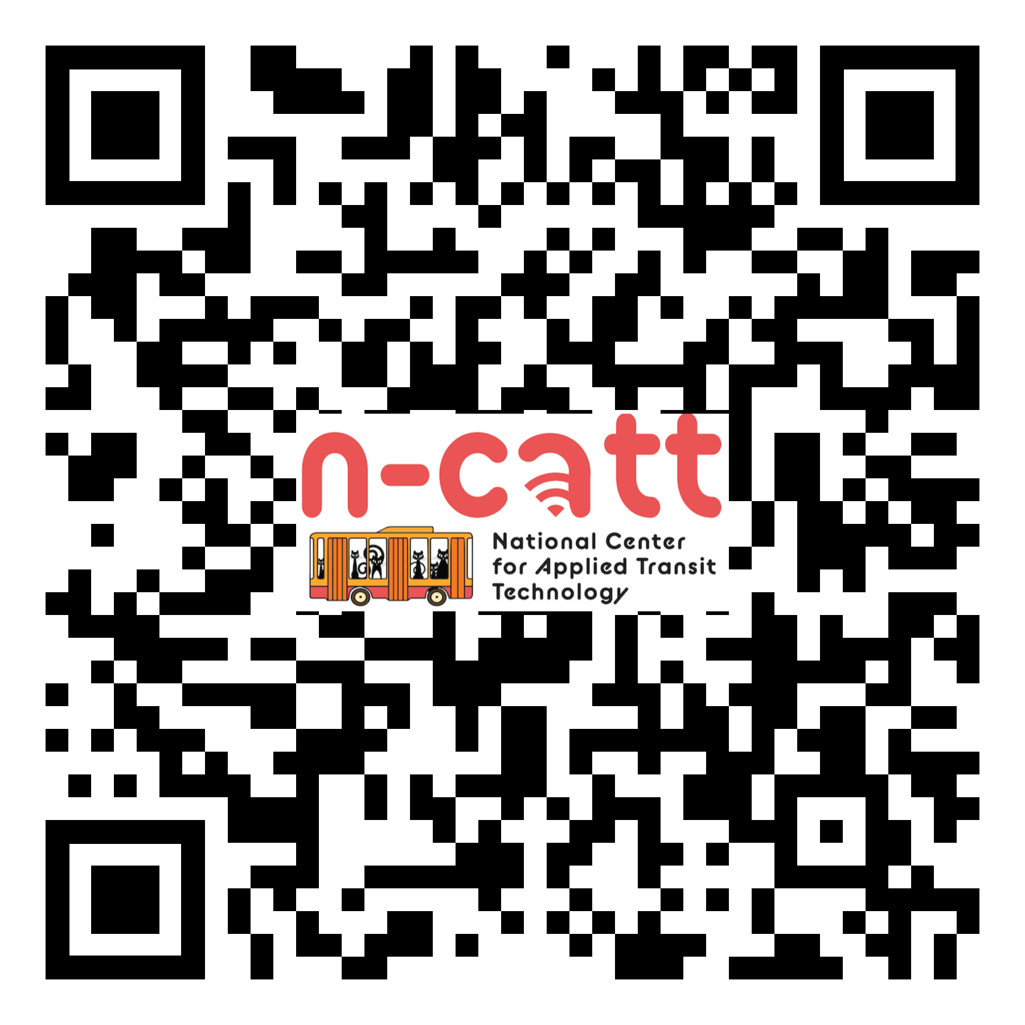
Questions!?
Contact Us:
Andrew Carpenter carpenter@ctaa.org
Erich Lange
lange@ctaa.org
N-CATT Newsletter
Recent transit news
Funding opportunities
Resources, skill-building & more

